Slide 1
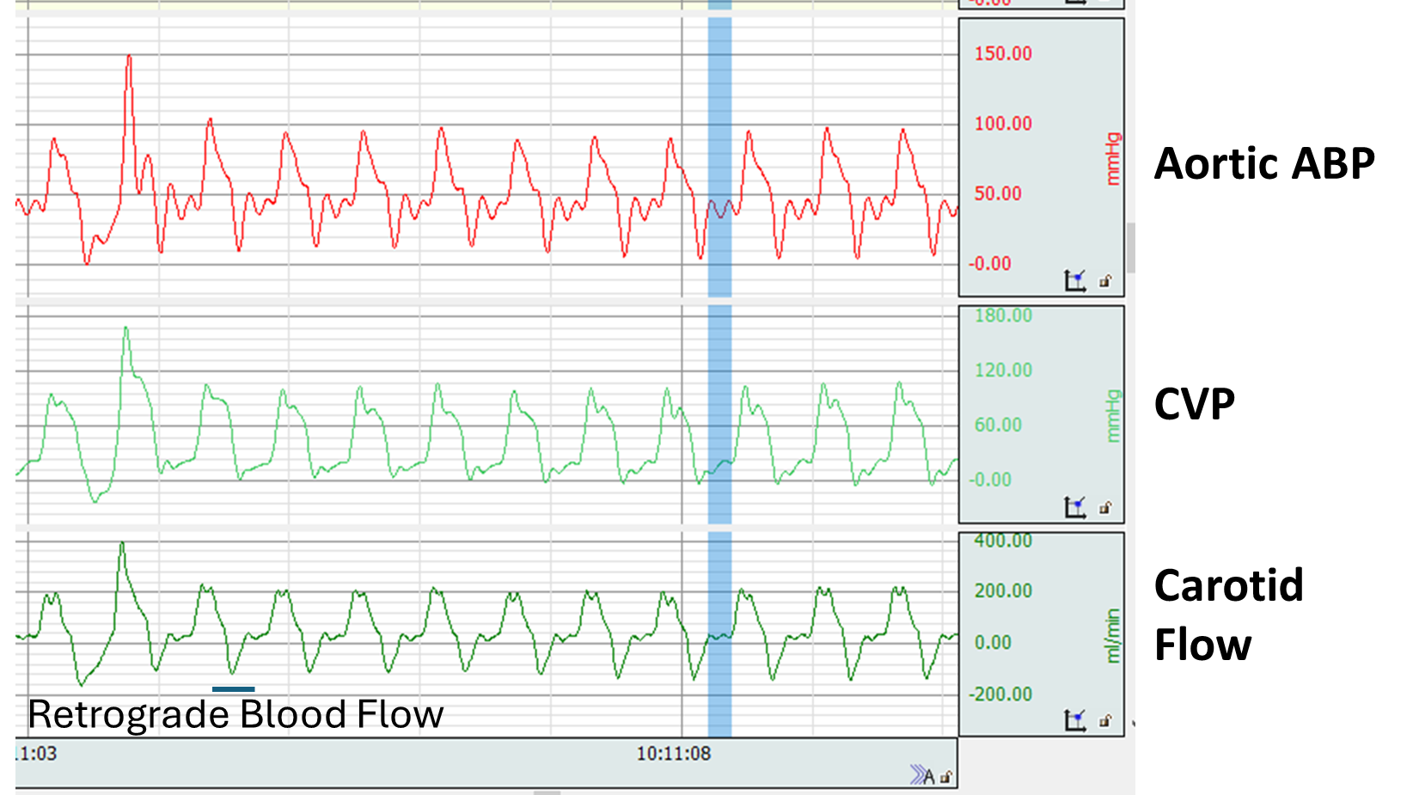
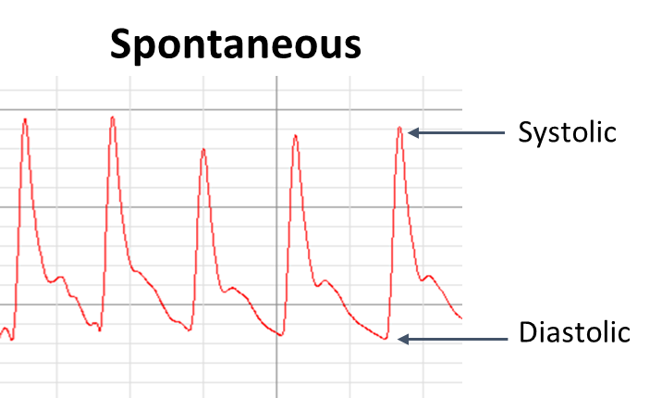
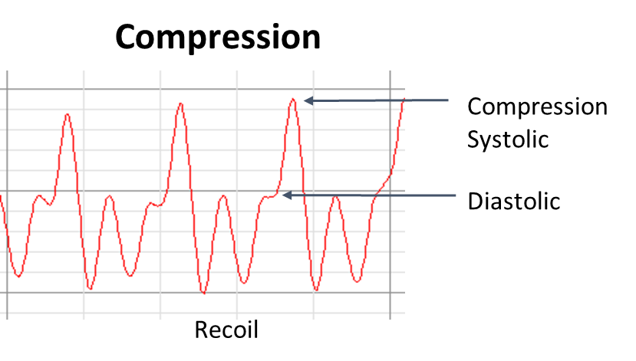
Cardiac Arrest: Problem
End-Diastolic
Diastolic blood pressure (DBP): proxy for coronary perfusion pressure when only arterial line available
Decompressions during cardiopulmonary resuscitation may generate distal arterial pressure drops and retrograde flow
This can cause issues when trying to use standard peak/local minima detection to analyze waveforms
Algorithms embedded on pressure monitors may have challenges
Many solutions for annotating the systolic and diastolic pressure during spontaneous beating exist
Limited work has been done for automatic analysis of waveforms during chest compressions in CPR

Slide 2
Data Description
NumPy array of shape (2 x 6800 x 400)
The two matrices that make up the first dimension are:
Input Data: 6,800 x 400 (# segments x # samples @ 200 Hz) of raw arterial waveform data across both chest compressions and normal beats
Label Data: 6,800 x 400 segments containing class labels for each of the 400 datapoints in a waveform segment
0: nothing
1: diastolic point during chest compression
2: systolic point during chest compression
3: diastolic point during normal heartbeat
4: systolic point during normal heartbeat
Each region around the point of interest is around 7 points wide
Please apply a machine learning approach to segment out the points of interest

